Slide 1

CSE316
OPERATING SYSTEMS
Lecture #0
The kick start session

Slide 2
Course Details
LTP – 3 0 0 [Three lectures/week]
Credit – 3

Slide 3
Course Outcomes
Through this course students should be able to:
CO1 :: understand the role, functionality and layering of the system software components.
CO2 :: use system calls for managing processes, memory and the file system.
CO3 :: Analyze important algorithms eg process scheduling and memory management algorithms.
CO4 :: use and outline the various security measures that ensure threat free operation of a system.
CO5 :: apply various operations on processes, threads and analyze methods to synchronize their execution.
CO6 :: simulate inter-process communication techniques like message passing and shared memory.

Slide 4
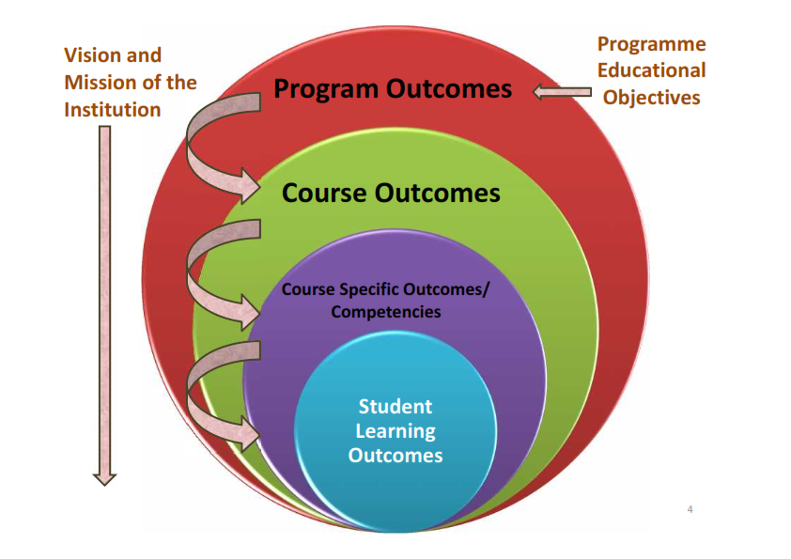
Program Outcomes
PO1: Engineering knowledge: Apply the knowledge of mathematics, science, engineering fundamentals, and an engineering specialization to the solution of complex engineering problems.
PO2:: Problem analysis: Identify, formulate, research literature, and analyze complex engineering problems reaching substantiated conclusions using first principles of mathematics, natural sciences, and engineering sciences.

Slide 5
Program Outcomes
PO3:: Design/development of solutions: Design solutions for complex engineering problems and design system components or processes that meet the specified needs with appropriate consideration for the public health and safety, and the cultural, societal, and environmental considerations.
PO4:: Conduct investigations of complex problems: Use research-based knowledge and research methods including design of experiments, analysis and interpretation of data, and synthesis of the information to provide valid conclusions.

Slide 6
Program Outcomes
PO5:: Modern tool usage: Create, select, and apply appropriate techniques, resources, and modern engineering and IT tools including prediction and modeling to complex engineering activities with an understanding of the limitations.
PO6:: The engineer and society: Apply reasoning informed by the contextual knowledge to assess societal, health, safety, legal and cultural issues and the consequent responsibilities relevant to the professional engineering practice.
PO12: Life-long learning: Recognize the need for, and have the preparation and ability to engage in independent and life-long learning in the broadest context of technological change.

Slide 7
Program Specific Outcomes
PSO1:: Apply skills for configuring and operating complex software systems, packages, tools and applications for sustainability in various domains.
PSO2:: Acquire skills to model, design, develop, manage and resolve issues related to robust computing applications and software solutions
PSO3:: Able to practice and promote computing technologies for societal needs and contribute to advancement of computer technology by means of research and development

Slide 8
Course Focus
In Computer Science and Engineering, Operating Systems is one of the scoring subjects for the GATE (Graduate Aptitude Test in Engineering) exam.
The GATE scorecard is also used by multiple PSUs (Public Sector Undertakings) to recruit applicants for various jobs, including service-based companies, govt. companies {Indian Oil, GAIL: Gas Authority of India Limited and Hindustan Petroleum etc.}
So, It is essential to know all the important concepts of an Operating System as it has an easily understandable theory and a set pattern of questions.

Slide 9
Course Content
Unit I
Introduction to Operating System : Operating System Meaning, Supervisor & User Mode, review of computer organization, introduction to popular operating systems like UNIX, Windows, etc., OS structure, system calls, functions of OS, evolution of OS
Process Management : PCB, Operations on Processes, Co-operating and Independent Processes, Inter-Process Communication, Process states, Operations on processes, Process management in UNIX, Process concept, Life cycle, Process and threads

Slide 10
Course Content
Unit II
CPU Scheduling : Types of Scheduling, Scheduling Algorithms, Scheduling criteria, CPU scheduler - preemptive and non preemptive, Dispatcher, First come first serve, Shortest job first, Round robin, Priority, Multi level feedback queue, multiprocessor scheduling, real time scheduling, thread scheduling

Slide 11
Course Content
Unit III
Process Synchronization : Critical Section Problem, Semaphores, Concurrent processes, Cooperating processes, Precedence graph, Hierarchy of processes, Monitors, Dining Philosopher Problem, Reader-writer Problem, Producer consumer problem, classical two process and n-process solutions, hardware primitives for synchronization
Threads : Overview, Multithreading Models, scheduler activations, examples of threaded programs

Slide 12
Course Content
Unit IV
Deadlock : Deadlock Characterization, Handling of deadlocks- Deadlock Prevention, Deadlock Avoidance & Detection, Deadlock Recovery, Starvation
Protection and Security : Need for Security, Security Vulnerability like Buffer overflow, Trapdoors, Backdoors, cache poisoning etc, Authentication-Password based Authentication, Password Maintenance & Secure Communication, Application Security - Virus, Program Threats, Goals of protection, Principles of protection, Domain of protection, Access matrix, implementation of access matrix, System and network threats, Examples of attacks

Slide 13
Course Content
Unit V
Memory Management : Logical & Physical Address Space, Swapping, Contiguous Memory allocation, Paging, Segmentation, Page replacement algorithms, Segmentation - simple, multi-level and with paging, Page interrupt fault, Fragmentation - internal and external, Schemes - Paging - simple and multi level, Overlays - swapping, Virtual memory concept, Demand paging

Slide 14
Course Content
Unit VI
File Management : File Concepts, Access methods, Directory Structure, File System Mounting and Sharing, Protection, Allocation methods, Free-Space Management, Directory Implementation
Device management : Dedicated, shared and virtual devices, Serial access and direct access devices, Disk scheduling methods, Direct Access Storage Devices – Channels and Control Units
Inter process communication : Introduction to IPC (Inter process communication) Methods, Pipes - popen and pclose functions, Co-processes, Shared memory, Stream pipes, FIFOs, Message queues, Passing File descriptors, Semaphores

Slide 15
Assessment/Evaluation Scheme
Attendance: 5%
CA: 25%
MTT: 20%
ETT: 50%
MTT and ETT will be MCQ.

Slide 16
Text & Reference Books
Text Books:
1. OPERATING SYSTEM CONCEPTS by ABRAHAM SILBERSCHATZ, PETER B. GALVIN, GERG GAGNE, WILEY
References:
1. DESIGN OF THE UNIX OPERATING SYSTEM by MAURICE J. BACH, Pearson Education India
2. REAL-TIME SYSTEMS by JANE W. S. LIU, Pearson Education India

Slide 17
Evaluation Criteria for the Course
CA1: 30 marks- Test (Quiz/MCQ of 30 Questions)
To assess the students’ understanding on Introduction to Operating System, Process Management, CPU Scheduling, and Process Synchronization
NOTE: The CA1 will be allocated in 3rd Week and conducted in 4th Week.
CA2: 30 marks- Test (Class Test- Student will write the answers on test sheets)
To assess the students’ understanding on Threads, Deadlock, Protection and Security, and Memory Management.
NOTE: The CA2 will be allocated in 7th Week and conducted in 8th Week.

Slide 18
Evaluation Criteria for the Course
CA3: 30 marks- Test (Term Paper)
To assess the students’ understanding of recent technology trends, they will be given topics upon which they will submit a term paper.
NOTE: The CA3 will be allocated in the 2nd Week and till the 12th Week students will show acceptance of the paper.
Instructions for CA3:
Students will be given a list of topics from which they will select a single topic for their term paper.
Maximum 3 students can be in a group.
Students will have to show the conference acceptance of the term paper they wrote before the deadline.
The best 1 out of CA1 and CA2 will be considered. CA3 is compulsory.

Slide 19
Open Educational Resource
https://onlinecourses.nptel.ac.in/noc24_cs108/preview

Slide 20
MOOC Detail
NPTEL (National Programme on Technology Enhanced Learning)
MOOC Title: Operating System Fundamentals
Exam Type: Proctored Exam
Benefit: All CA, MTE, ETE waive off (if student pass the exam)
MOOC Link:
https://onlinecourses.nptel.ac.in/noc24_cs108/preview

Slide 21
Mapped Cohorts
SOFTWARE DEVELOPMENT-(Product Based and Service Based)
A Product-Based Company is one that has its own product to sell to consumers through the market.
The product-based company list includes Microsoft, Google, Amazon, Apple, Cisco, Adobe etc…
A Service-Based Company is an enterprise, that offers services to its clients.
TCS, Wipro are some examples of service-based companies

Slide 22
Mapped Cohorts
The business environment relies heavily on software for many functions - from automated traffic control systems to complex manufacturing processes.
Software Engineers are pivotal in developing software that provides real solutions.

Slide 23
Mapped Cohorts
A Software Engineer needs to address the entire software development lifecycle - to analyze the needs, and then design, test, and develop software to meet those needs.
The career of a software engineer typically follows one of two primary paths:
  they either progress through greater responsibility and ownership over technical architecture and systems or
  progress into managing software engineering teams.

Slide 24
OS as a Star Course
Operating system interview questions are mostly focused on process management(fork()), CPU scheduling algorithms, difference between a process and a thread, critical solution problem (mutex and semaphore) and memory management in operating system.

Slide 25
Relevancy of OS for Placements
Operating system is one of the most important topic for Placement preparation. Following are the most important topics for Operating Systems –
CPU Scheduling
Process Synchronization
Deadlocks
Processes and Threads
Memory Management
File and Disk Management
Algorithms

Slide 26
Importance of the Course
Many recruiters (like TCS, CTS, HCL, IBM, Tech Mahindra, Amdocs, etc.) ask about operating systems in Technical Quiz and Technical Interview round.
This course is essential for GATE aspirants, it has good weightage (10%) in GATE.

Slide 27
What is the %age weightage of operating systems subject in GATE Exam:
a. 13%
b. 10%
c. 17%
d. 20%

Slide 28





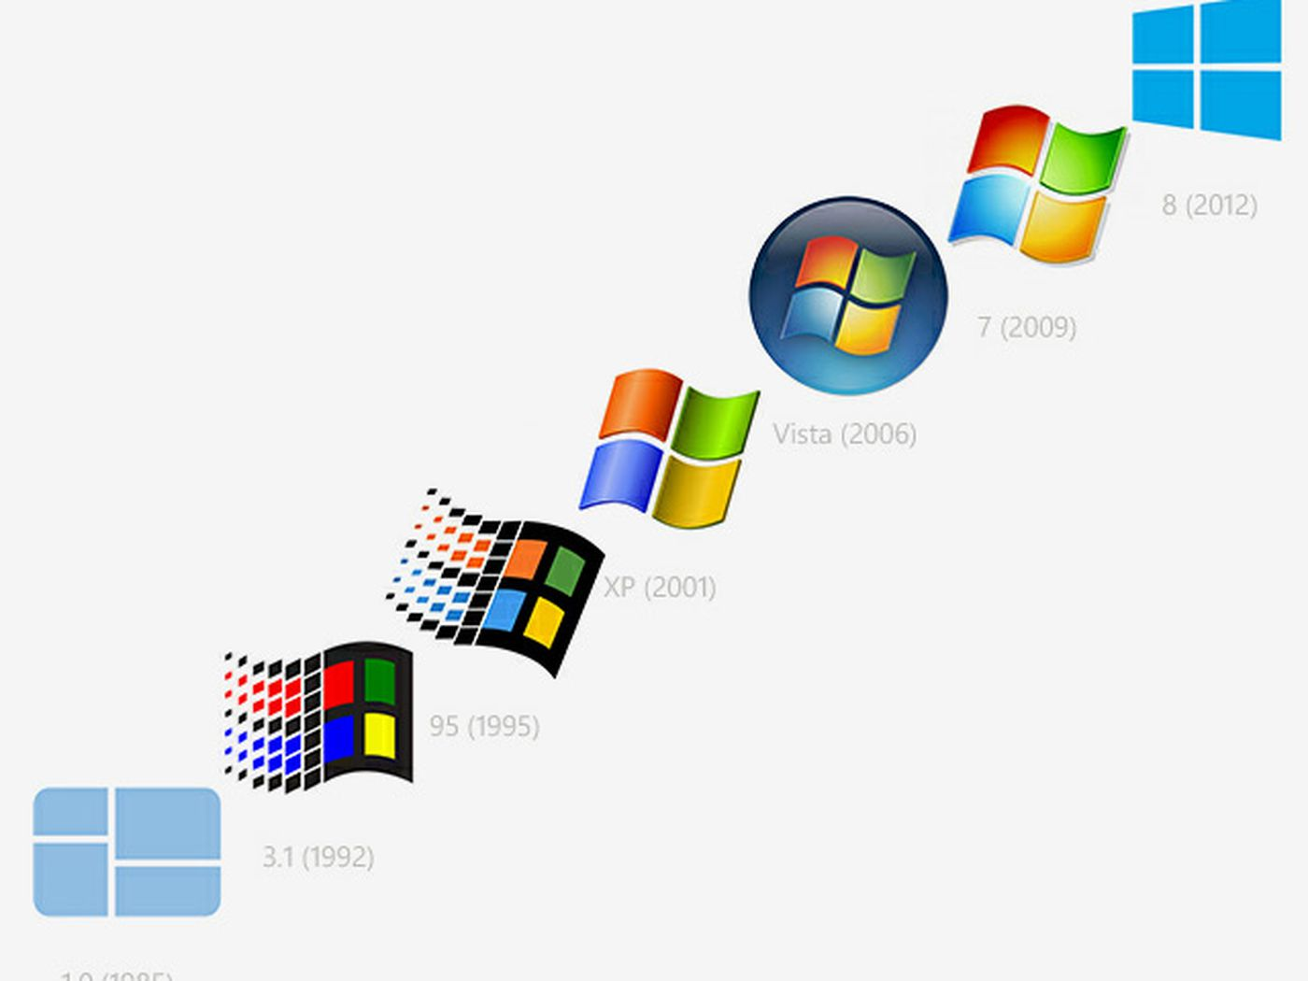


Operating Systems

Slide 29
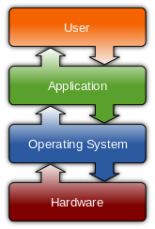
WHY
OPERATING SYSTEM?

Slide 30
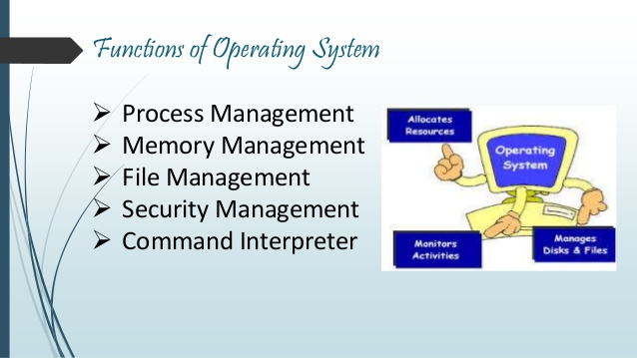
Unit 1
Introduction to Operating System

Slide 31
Unit 2
CPU Scheduling
Which process to execute in which order?
Scheduling Criteria
Scheduling Algorithms

Slide 32
CPU Scheduling
Throughput: number of processes completed per unit time.
Turnaround Time: mean time from submission to completion of the process. turnaround time is the total time taken between the submission of a program/process/thread/task for execution and the return of the complete output to the customer/user.
Waiting Time: Amount of time spent ready to run but not running.
Response Time: Time between submission of requests and first response to the request.

Slide 33
Unit 3
Process Management
Managing all the processes that are running on a computer and
allocate each process a certain amount of time to use the
processor.

Slide 34
Unit 4
Deadlock
Deadlock Prevention
Deadlock Avoidance & Detection
Deadlock Recovery
Starvation
Critical regions

Slide 35
Unit 4
Security and Protection
Protection
Access matrix
System and network threats
User authentication

Slide 36
Unit 5
Memory Management
Swapping Schemes
Paging
Demand paging
Page interrupt fault
Page replacement algorithms
Segmentation

Slide 37
Unit 6
File Management
Files and Directories
Directory structure
Accessing Data

Slide 38
Unit 6
Device Management
Serial access devices
Direct access devices
Disk scheduling methods
Direct Access Storage Devices

Slide 39
Unit 6
Inter-Process Communication
Information Sharing
Resource Sharing
Process Control
Event Notification

Slide 40
What of the following is not the type of OS:
a. Windows
b. RHEL
c. Oracle
d. Android

Slide 41

Zero Lecture - Feedback
Please refrain from including your name or registration number in your feedback. Your honest opinions shall be valued and appreciated.
or visit URL:
https://forms.gle/KViuXpJEtN2rzG5A9

Slide 42
Any Query?

